Slide 1
Quantum Superposition & Entanglement
Sneh Mehta • Algorithms (PROG 366)

Slide 2

Introduction to Quantum Programming
Definition of a Qubit
Where classical bits hold a single binary value such as 0 or 1, the state of a qubit can be in a “superposition” of 0 and 1 simultaneously.
Can be thought of as a vector - (direction in space), a qubit can be in any of the possible directions .
The two classical states of 0 and 1 are the two directions; representing 100% chance of measuring 0 and 100% chance of measuring 1.
Act of Measurement
Produces a binary result and changes a qubit state. Either 0 or 1.
The qubit goes from being in superposition (any direction) to one of the classical states.
Entanglement
Multiple qubits can be entangled. When we make a measurement of one entangled qubit, our knowledge of the state of the others are updated as well.
This project explores how Quantum superposition works and what Quantum entanglement is using Q#

Slide 3
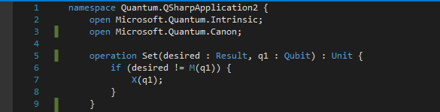
Setting Up Qubits
Operation Explanation
This operation can now be called to set a qubit to a classical state, either returning zero 100% of the time or one 100% of the time.
Set operation measures the qubit -> if the qubit is in the state we “desire” Set leaves it alone, otherwise, by executing the X operation, we change the qubit state to the desired state.
What is X….?

Slide 4
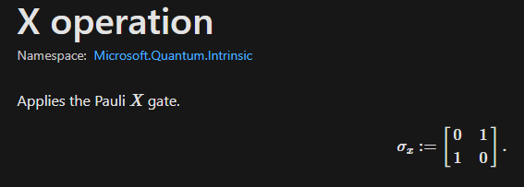
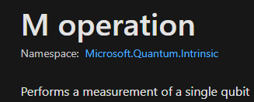
Fun Facts about Q# operations
Key Pieces of Knowledge
A Q# operation is a quantum subroutine.
The M operation: measures the state of the qubit
The X operation: flips the state of a qubit
A quantum operation transforms the state of a qubit. Sometimes operations are referred to as quantum gates - in analogy to classical logic gates.
Ex: AND, NOR, XOR, CNOT
= 1
= 0
X operation
= 0
= 1

Slide 5
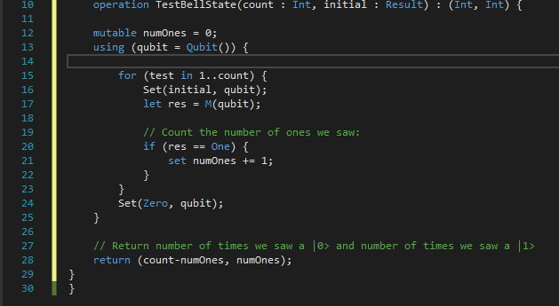
Testing Bell State
*Bell states are specific quantum states of two qubits used to represent the simplest examples of superposition and entanglement
Q# Code Breakdown
This operation TestBellState will loop for count iterations, set a specified initial value on a qubit and then measure (M) the result.
Gather statistics on how many zeros and ones we’ve measured and return them.
Resets the qubit to a known state (zero) before returning it, allowing it to allocate this qubit in a known state -- required by using statement

Slide 6
Fun facts about Q# variables
Mute - Unmute?
Default variables are immutable -> value may not change after bound.
If you require a variable whose value can change such as numOnes, you can declare with mutable.
Immutable or Mutable -> type of a variable is inferred by the compiler. Q# doesn’t require: “int”, “string”, etc.
Using Statements
The Using statement is special to Q#. Used to allocate qubits in a code block: dynamically allocated and released.
Like memory in C++

Slide 7
Back to Coding

Slide 8
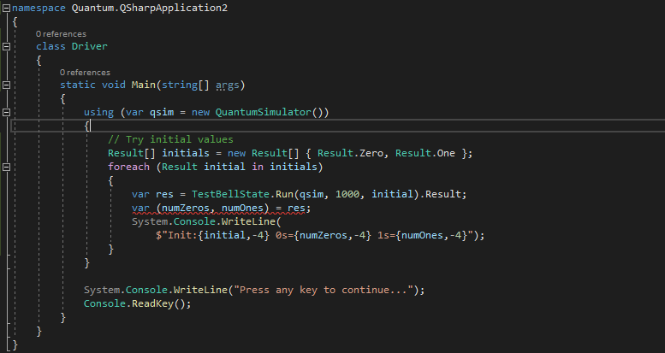
Host Application Code
*.cs file to run and simulate a Quantum computer simulation
Construct a quantum simulator -> qsim = new QuantumSimulator()
Compute any arguments required for the quantum algorithm -> Count = 1000, initial is the initial value of the qubit
Run the Quantum algorithm
Each Q# operation generates a C# class with the same name
This class has a run method that asynchronously executes the operation.
Because run is asynchronous -> fetch the result property; this blocks execution till task completes and returns the result asynchronously.
Process the result of the operation
Here the result is a tuple of the number of zeros (numZeros) and number of ones (numOnes) measured by simulator.

Slide 9
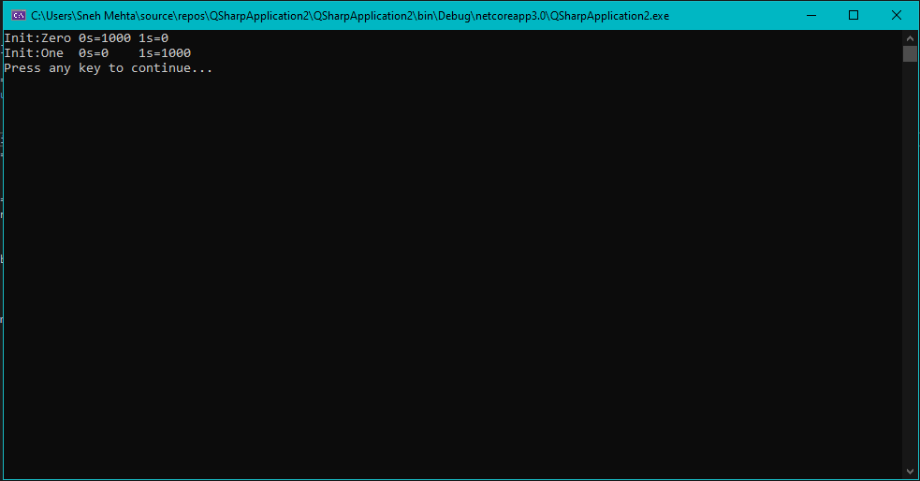
Output:

Slide 10
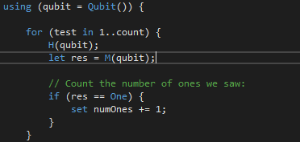
Preparing Superposition
Quick Recap: Qubits can be in a superposition of 0 and 1, meaning in between at any point.
Hadamard operation (H)
If a qubit is in either of the classical states (where a measurement returns zero always or one always), then the H operation will put the qubit in a state where a measurement of a qubit will return zero 50% of the time and one 50% of the time.
Conceptually thought as halfway between 0 and 1.
Now when we run TestBellState -> we will see results returned as roughly an equal number of zero and ones.
*Apply the hadamard operation

Slide 11
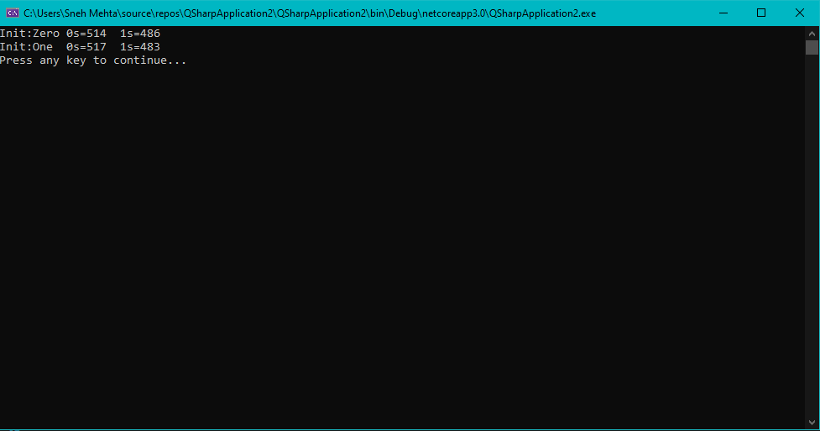
Output:
SUCCESS! Everytime we measure, we ask for a classical value, but the qubit is halfway between 0 and 1, so we get (statistically) 0 half the time and 1 half the time. *THIS IS KNOWN AS SUPERPOSITION*

Slide 12
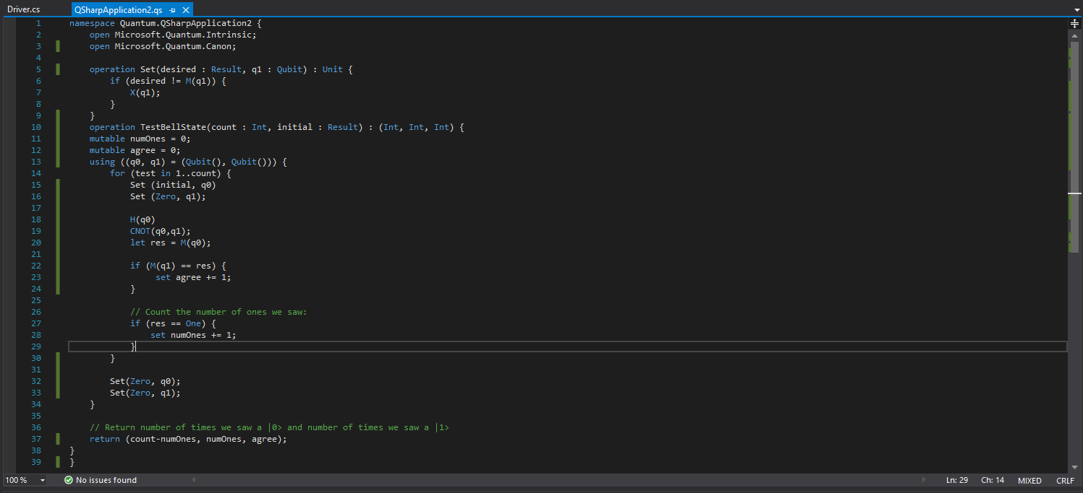
Preparing Entanglement
First we set the first qubit to the initial state -> then use the H operation to put it into superposition
Before measuring the first qubit however -> need to implement a CNOT quantum gate.
*CNOT entangles the two qubits, so that whatever happens to one of them happens to the other*
Allocate 2 qubits instead of 1
CNOT (q0, q1)
Set (Zero, q0)
(Zero, q1)
To initialize the first qubit to make sure that it is always in zero state

Slide 13
Entanglement Cont..
Interested in how the second qubit reacts to the first being measured.
New return value (agree) keeps track of every time the M of q0 matches the M of q1
Q0 = qubit 1
Q1 = qubit 2

Slide 14
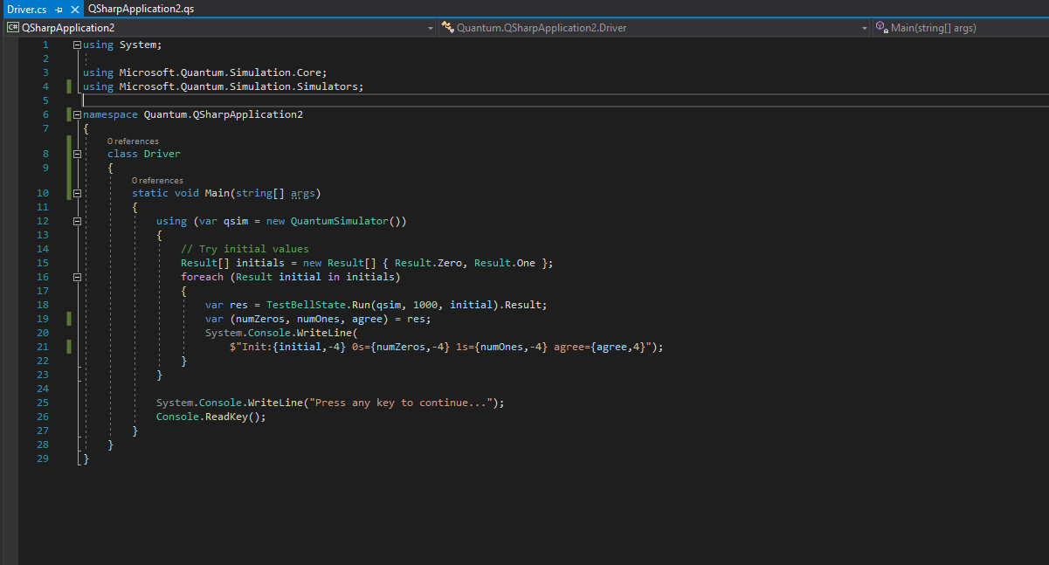
Tease before output:
We have to update the .cs Host code too!

Slide 15
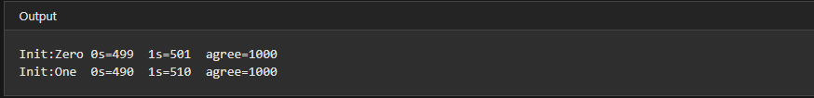
Output:
Notice qubit statistics haven’t changed (still a 50% chance of either 0 or 1) but now when we measure the second qubit, it is always the same as what we measured for the first qubit, because they are entangled. ← Quantum Entanglement

Slide 16
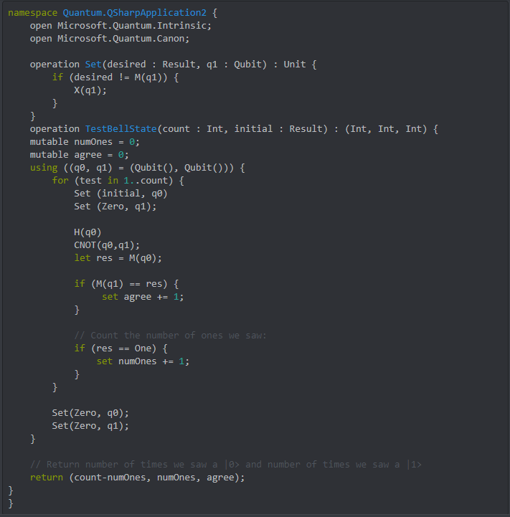
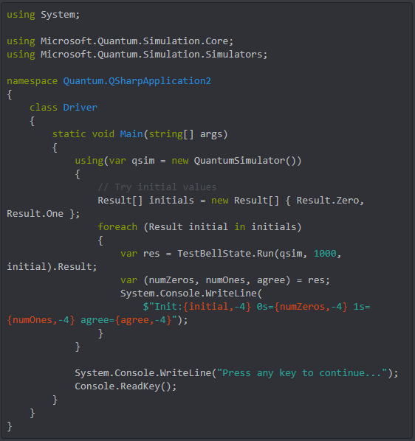

Slide 17
Sources
Source 1
https://docs.microsoft.com/en-us/quantum/?view=qsharp-preview
Source 2
https://docs.microsoft.com/en-us/quantum/quickstart?view=qsharp-preview&tabs=tabid-python
Please refer to QSharpApplication2 project submit

